Slide 1
Purchase Orders
Notes:
Class starts assuming you are working off of a PR
Class does not cover competition- that is done outside of Pegasys

Slide 2
Purchase Orders
A vehicle used for the government to order goods and/or services that states the cost and vendor.
A Purchase Order is used once a Purchase Request for goods or services has been approved
A Purchase Order is used to create an obligation within Pegasys that records the accounting and budgetary impact of the order.

Slide 3
Purchase Order - Standard Purchasing Chain
Invoice
M7/M6
Request
PR
Order
GP
QP,FP,TP
OP
XP
PJ, PN, PP
Payment
Authorization
P7/P6
Receipt
RW/RK
A purchase request (PR) is not needed to create an order, but highly recommended
Notes:
We are copying forward from PR to GP- we just fill in the missing information

Slide 4
Purchase Order - Standard Purchasing Chain
Invoice
Request
Order
Payment
Authorization
Receipt
ORDER
Obligates funds.
Legal contract with vendor.
Decreases available budget and plan amounts (obligation-based budget only).
Must be approved before it can be processed.
Entered into Pegasys by an Authorized Buyer, or Contracting Officer.
Notes:
This box is what an Order is
When you get the message “Order was successfully completed” the $ has been taken down from the budget
Authorized Buyer is for orders <$3000
Contracting Officer is for orders >$3000

Slide 5
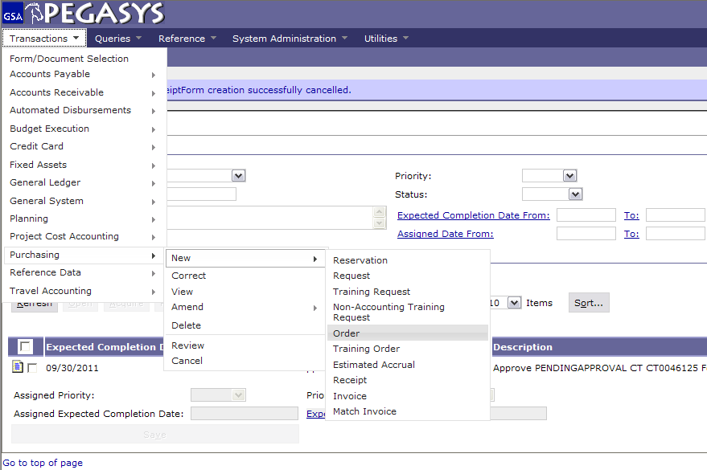
Create a Purchase Order
Select :
  - Transactions
  Purchasing
  - New
  - Order
Notes:
PR is “Copied Forward” to the GP
Once it is an Order, it is an Obligation. (Undelivered Order)
Once Order-Invoice-Receipt match Pegasys Pays the Vendor- money is no longer GSA’s
If you do not like it or do not want it, do not do a Receipt. Otherwise, Pegasys will pay it

Slide 6
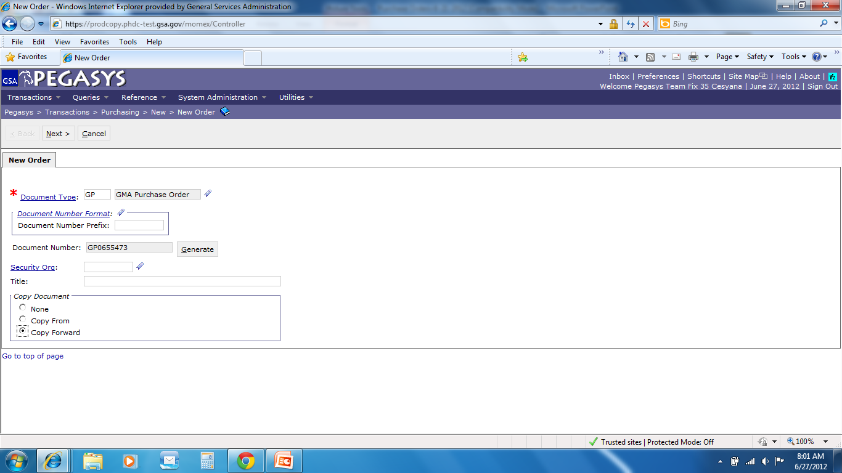
Purchase Order
Enter Doc Type
Press Tab
- Click Generate
- Select Copy Forward
- Click Next
Doc Type
QP, FP, TP = FAS
GP = GM&A
PP = PBS
XP = Client
OP = Other
CO = DC Courts
Copy Forward
Copies information from the previous document (PR) in the chain
Notes:
With PJ/PN you don’t hit Generate – you type in the number given to you by Comprizon

Slide 7
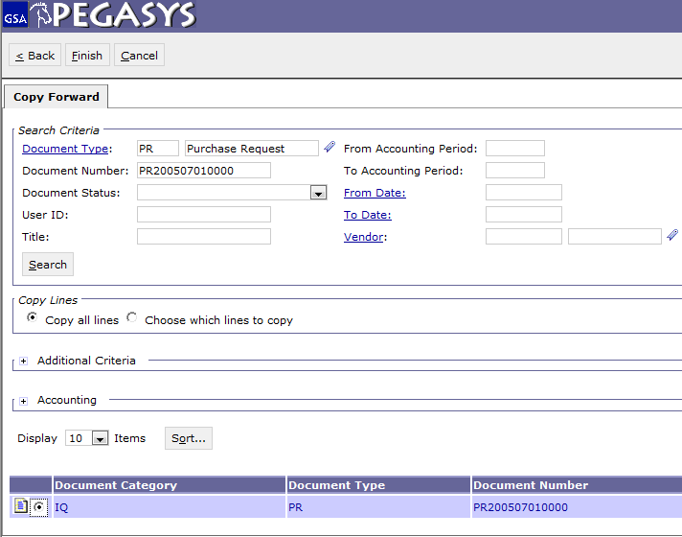
Copy Forward
Enter :
Document Type
Document Number
Click :
- Search
Highlight :
- Document
Click :
- Finish

Slide 8
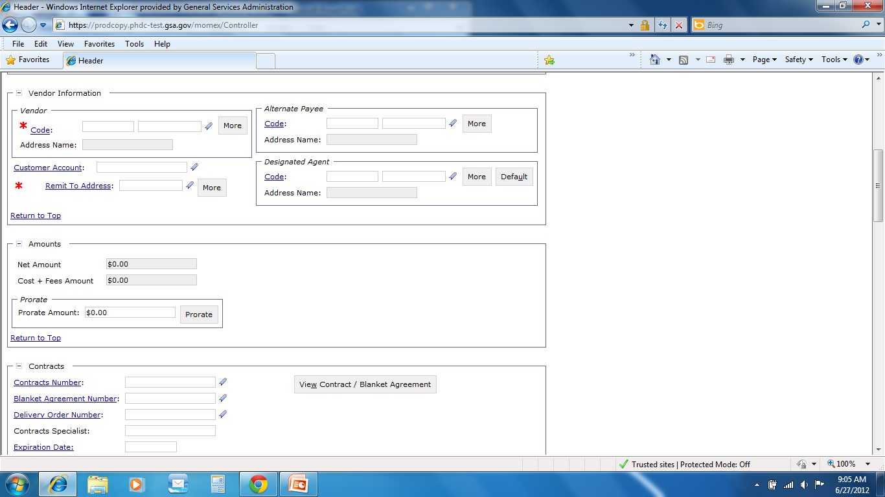
Vendor
Save Often
Click :
Code (in vendor box)

Slide 9
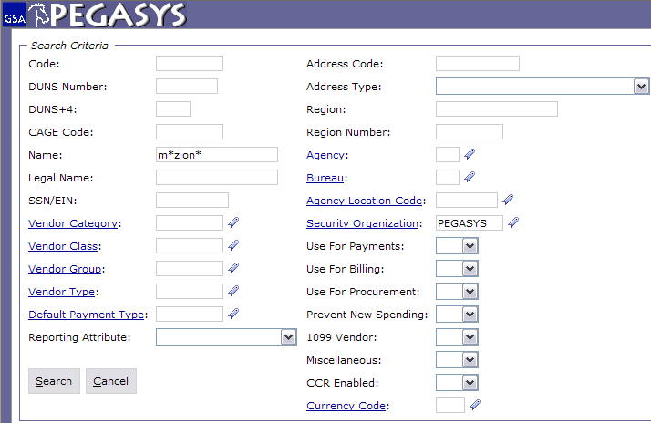
Vendor Code Search
Enter :
Code – Tax Identification Number (TIN)
or DUNS
or Name
*Intelligent*
Enter :
Pegasys (in Security Org)
The * is a wild card for searching
Notes:
Code is the TIN # (tax identification number)
Use wild card because Pegasys looks for an exact match Example: Inc does not equal Inc.
If the vendor isn’t in Pegasys then you can email the finance centers in FW and KC to get the vendor put in. Takes less then 24hrs

Slide 10
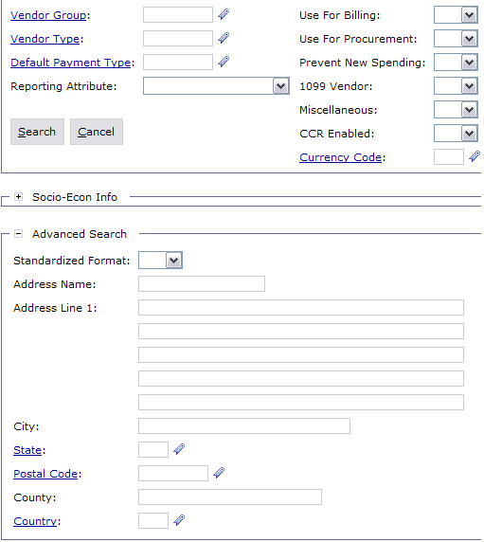
Vendor Advanced Search
To assist in narrowing down the search
Enter :
City and/or State
Click :
- Search

Slide 11
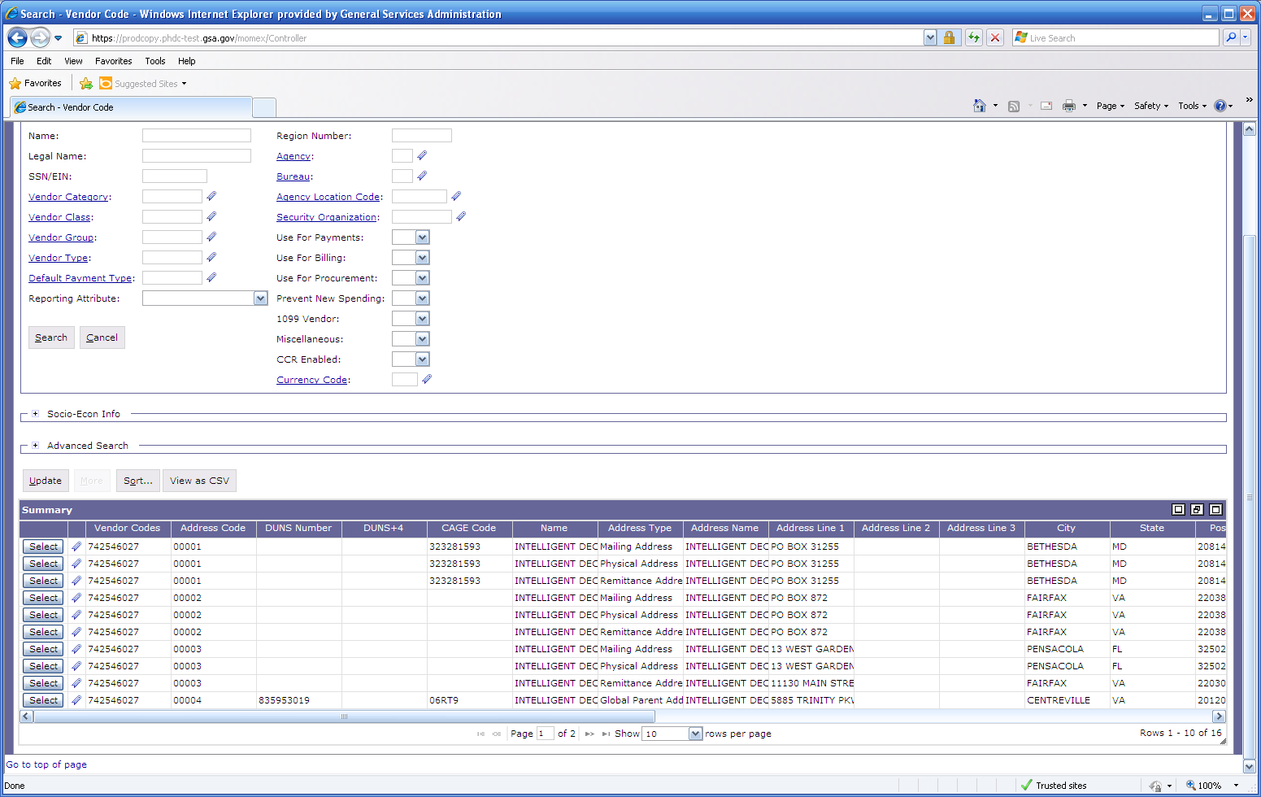

Vendor Results
Click on Favorites icon to save Vendor Address Code
Click Select
to populate field
https://finance3.gsa.gov/

Slide 12
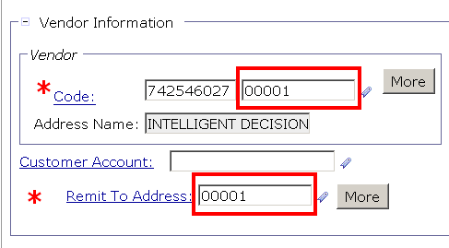

Remit To Address
Enter :
- Remit To Address
The favorites icon can be used to populate this information as well.

Slide 13
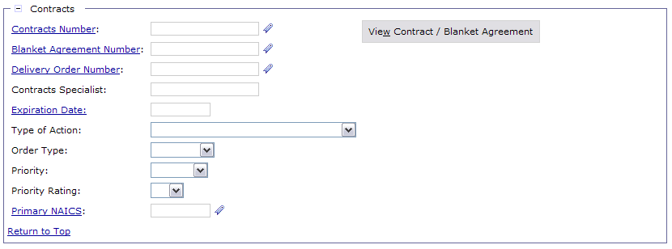
Contract Section
Contract Number is found in Comprizon
Blanket Number does not need a contract number
Delivery Order number is GSA Schedule number (done by Contract Officers & Contract Specialists)
**If there is no contract number, Enter “Open Market” for Contract Number
GS-01P-09-BW-D-0009
GS00I11AAC0253

Slide 14
Contract Section
Contract Number is found in Comprizon
Blanket Number does not need a contract number
Delivery Order number is GSA Schedule number (done by Contract Officers & Contract Specialists)
**If there is no contract number, Enter “Open Market” for Contract Number
OPEN MARKET
GS00I11AAC0253

Slide 15
Contract Section
Contract Number is found in Comprizon
Blanket Number does not need a contract number
Delivery Order number is GSA Schedule number (done by Contract Officers & Contract Specialists)
**If there is no contract number, Enter “Open Market” for Contract Number
BPA-GSA-BC02-0001
0118

Slide 16
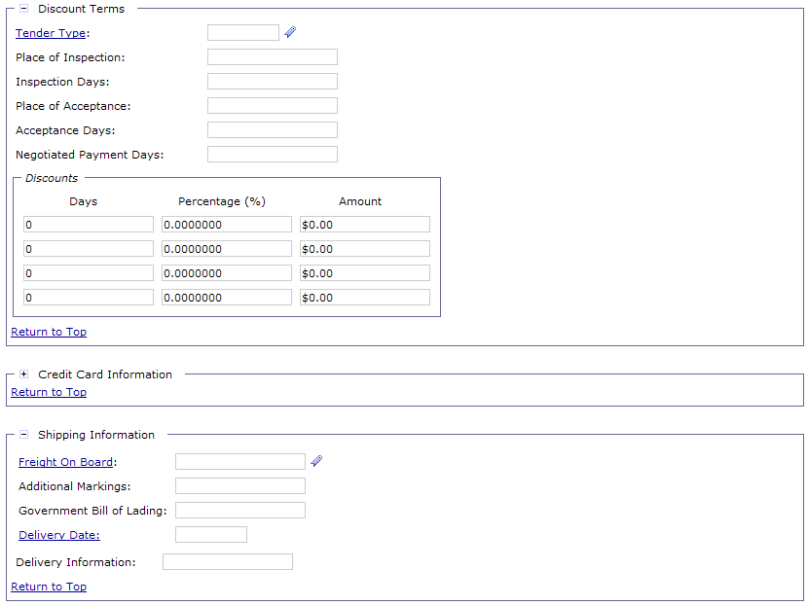
Discount Terms and Shipping Information Section
Enter :
- Discount
Terms

Slide 17
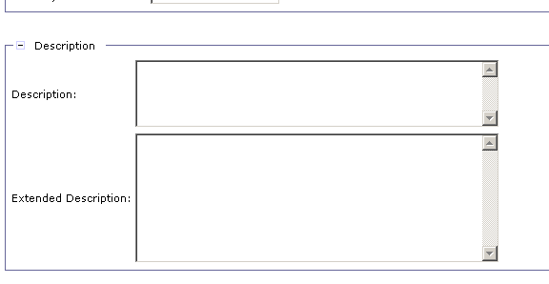
Description
Description is copied from the Purchase Request
Enter :
- Description

Slide 18
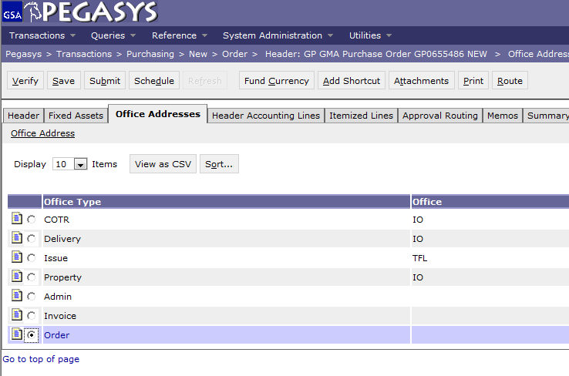
Office Addresses
Save Often
Click :
Office Addresses
Highlight :
Address line
Click :
- Office Address hyperlink
Required Addresses :
Invoice
Order
Invoice Address Code should be KCAP or FWAP
Notes:
Delivery and Issue come from PR
Order is where the 2nd email will be sent prompting you for a receipt

Slide 19
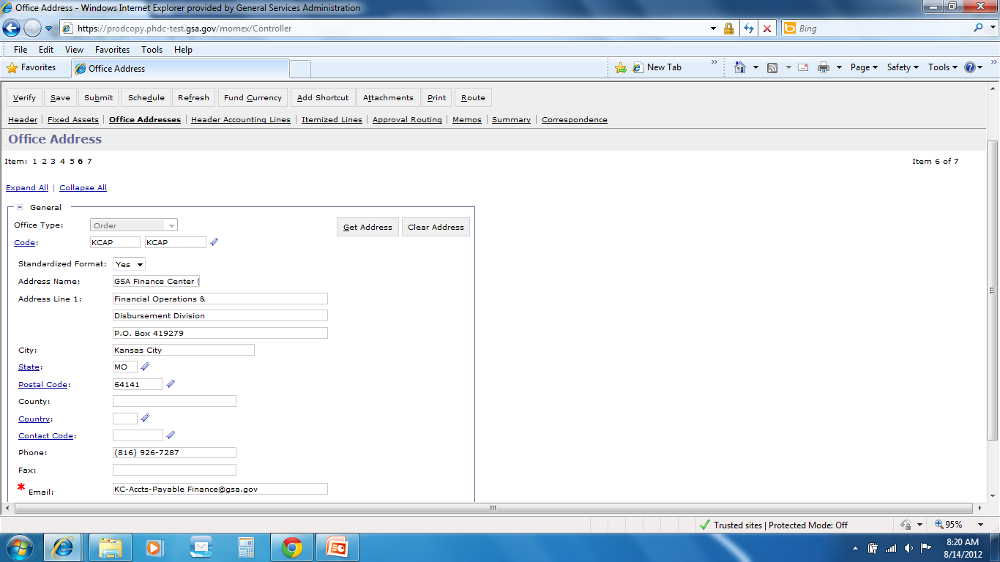
Office Address
Enter :
Code
Click :
- Get Address
or
- Type in Address
  For information on how to use office defaults, go to http://pegasys.gsa.gov/ref/howto.htm
Email address is where second request for receipt is sent.

Slide 20
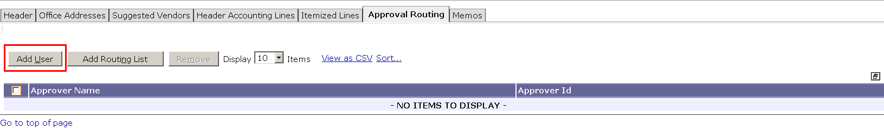
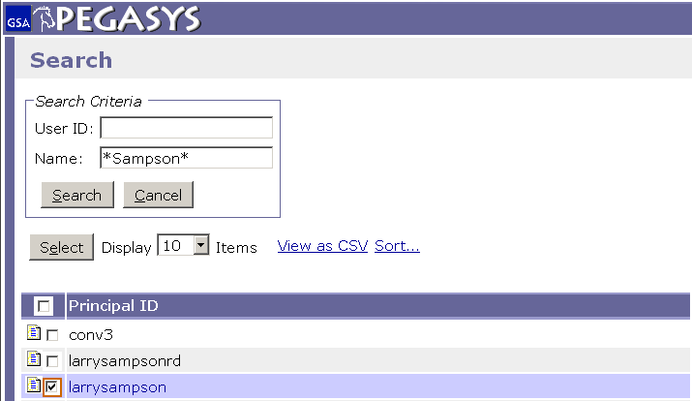
Approval Routing (Add User)
Approval Type
Authorized Buyer - $3000 or less.
Contracting Officer - if greater than $3000.
- Click Approval Routing
- Click Add User
- Enter Approver Name
- Click Search
Highlight Line
- Click Select
The * is a wild card for searching
Notes:
If the approver has a backup Pegasys will send to both. If one approves it, it will show up to the other as Acquired and won’t be accessible.

Slide 21
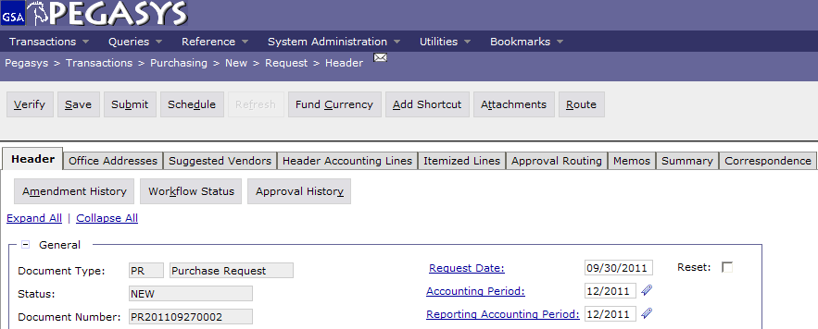
Save, Verify, Submit
  To finish the Form:
  - Save the form
  - Verify and correct any errors
  - Submit the document for approvals and processing

Slide 22
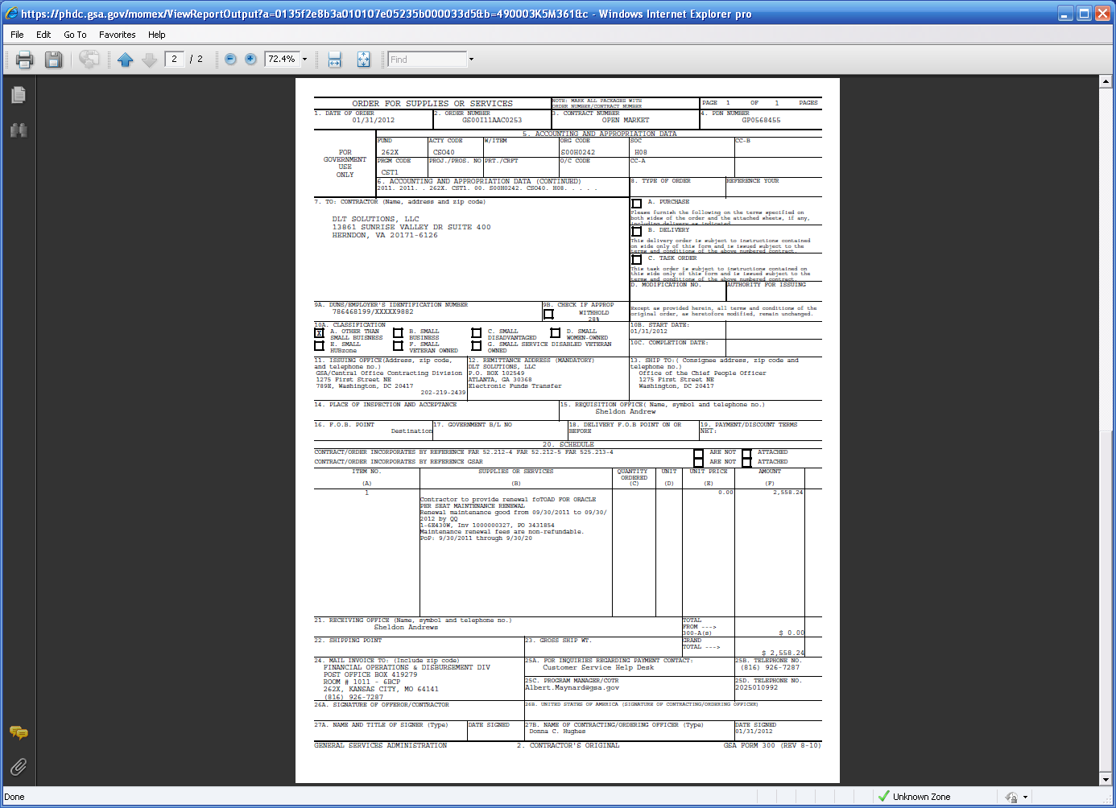
Sample GSA Form 300
Notes:
This is just the recording of the amendment in Pegasys, you still need to do all other things outside of Pegasys.

Slide 23
Sample GSA Form 300 (2)
Notes:
This is just the recording of the amendment in Pegasys, you still need to do all other things outside of Pegasys.

Slide 24
Amendments
Creating an Amendment
An amendment is created when there are
changes that need to be made to the
document
Notes:
This is just the recording of the amendment in Pegasys, you still need to do all other things outside of Pegasys.

Slide 25
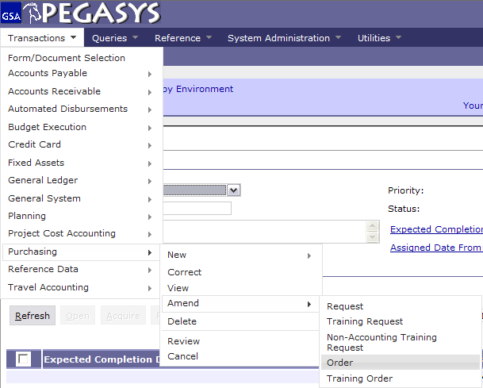
Creating an Amendment
Select :
- Transaction
- Purchasing
- Amend
- Order
Notes:
If this is your 2nd Amendment then it won’t let you put 1.

Slide 26
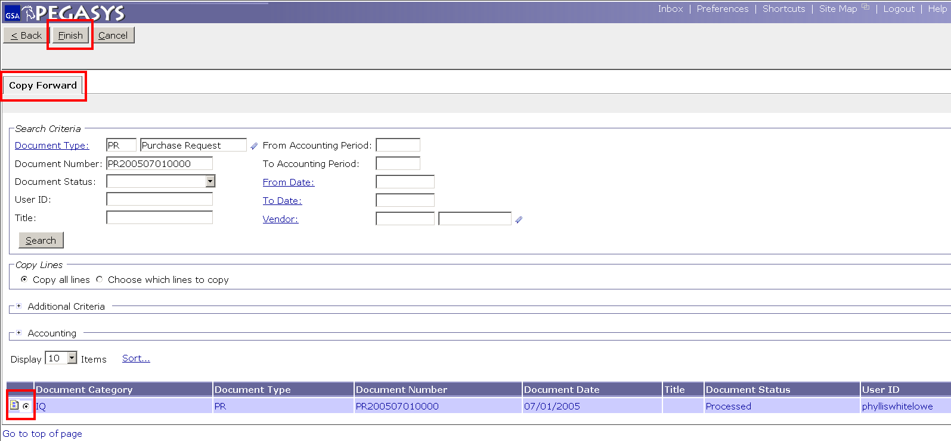
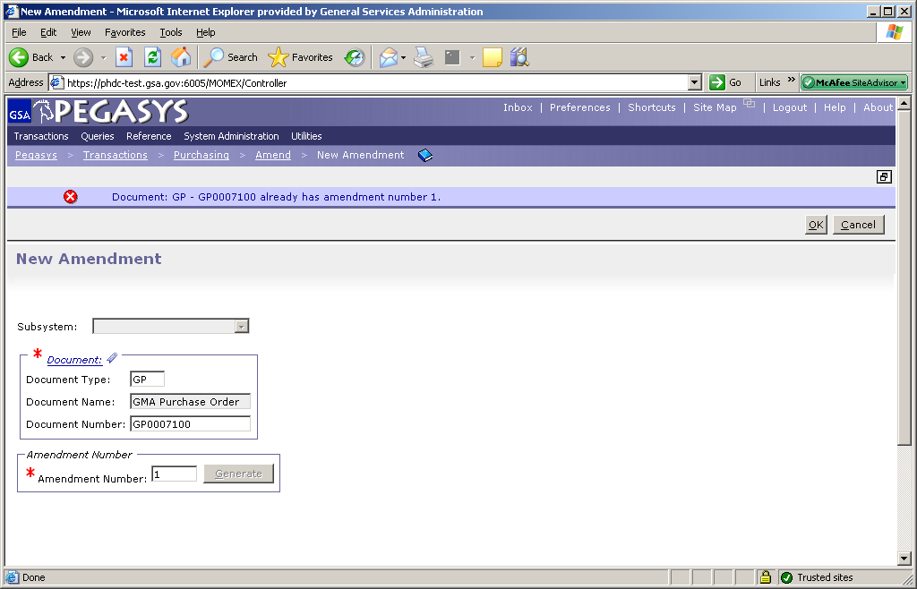
New Amendment
Enter :
Document Type
Document Number
Amendment Number
Click :
- Finish
01

Slide 27
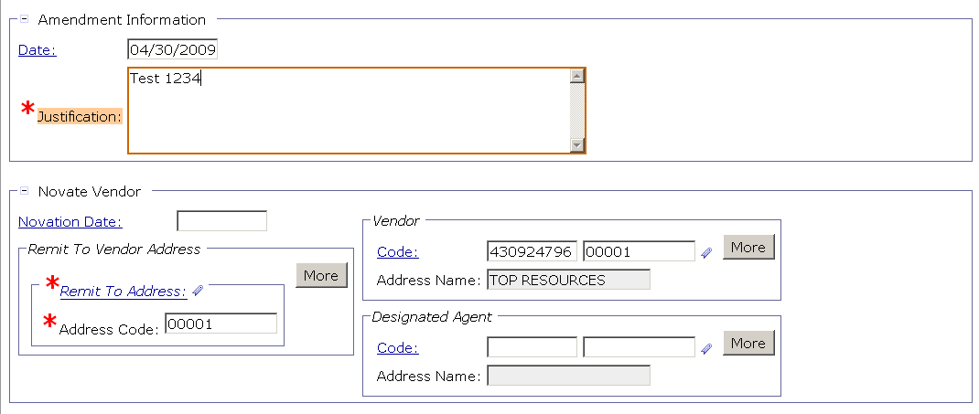
Purchase Order - Amendments
Enter :
- Date
- Justification
Notes:
Amend has a spot for justification, this is the difference between Correct and Amend.
Amend=when you change the scope of the order, something that effects the vendor
Correct= when something internal changes, exp is a change in the funding code, something that doesn’t effect the vendor
Amend is better because it leaves an audit trail, with Correct things change and nobody knows what changed or why

Slide 28
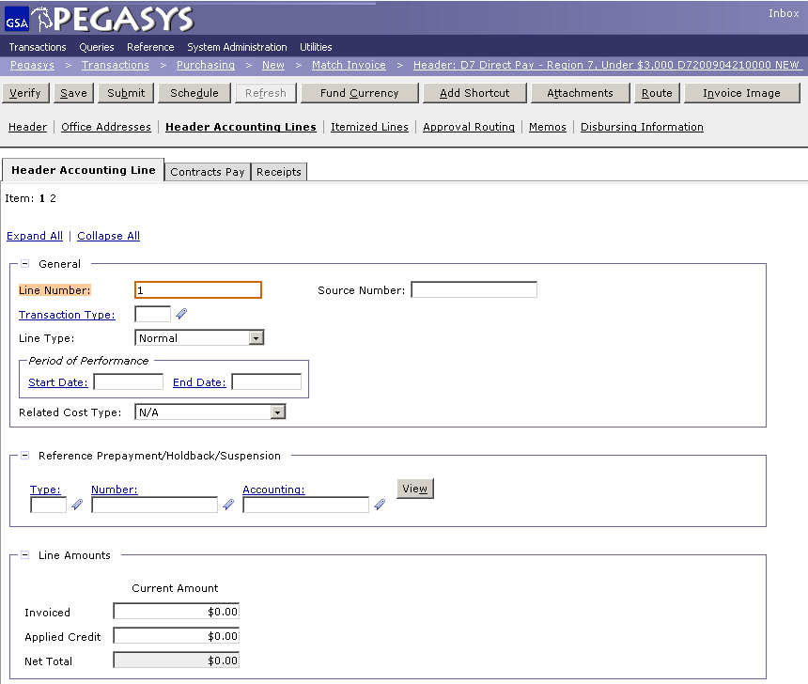
Amendment - Amount
Enter :
- Line Amounts

Slide 29
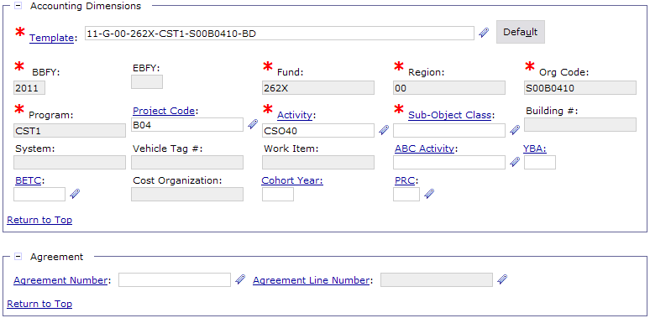
Purchase Order - Amendments
Enter your accounting changes:
Accounting Template
Activity
Sub-Object Class (SOC)
Building Number
Vehicle Tag
Work Item
Etc
Note: Approval is needed when changing the funding, accounting template and/or dollar amount.

Slide 30
Save, Verify, Submit
  To finish the Form:
  - Save the form
  - Verify and correct any errors
  - Submit the document for approvals and processing

Slide 31
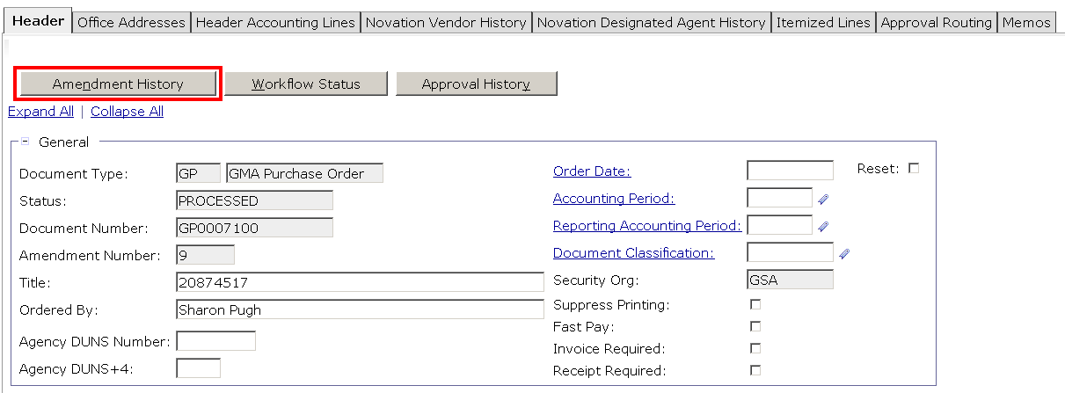
View Amendment History
Click :
- Amendment History

Slide 32
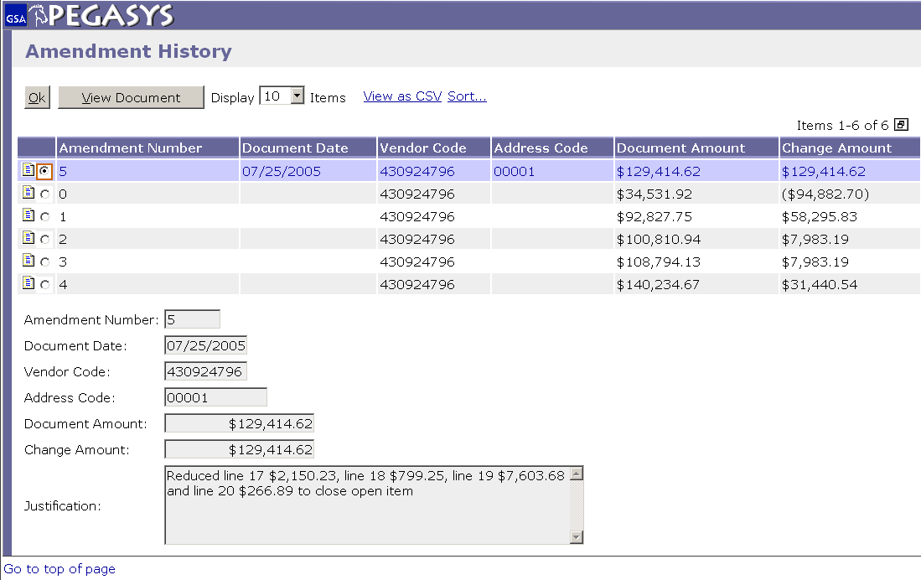
View Amendment History
Highlight :
- Amendment Line
Click :
- View Document

Slide 33
Additional Assistance
Pegasys Web Site - http://pegasys.gsa.gov
  User Guides
  Quick Reference Cards
  Pegasys Training Classes
OCFO Consolidated Service Desk
  1-866-450-6588
  ocfoservicedesk@gsa.gov
ocfocustomerservice.gsa.gov
Notes:
If 90% of the time when you do a credit card it is same funding then set up the accounting string as a default.

Slide 34

Goals of Information Security
Confidentiality
  Data must be protected against unauthorized disclosure
Integrity
  Systems must not permit processes or data to be changed without authorization
Availability
  Systems must be functional and operational
Confidentiality
Availability
Integrity
Notes:
Please take a few moments and review the remaining slides on Information Security

Slide 35
Why is Information Security Important?
Must be in compliance with regulatory requirements such as OMB Circular A-130, Computer Security Act, FISMA and GSA IT security policies
Protects GSA information resources from potential abuse and misuse
Follows sounds business practices

Slide 36
User Responsibility
Responsible for adherence to GSA information security policy
Protect Pegasys login ID and password
  Do not allow others to use your login ID / password
  Do not write it down
Log out whenever you are not using Pegasys
Protect sensitive information
  Shred reports containing sensitive information
Report security incidents
  Refer to OCFO Incident Handling Procedures for further guidance
  Report security incidents to your supervisor

Slide 37

Keys to Incident Prevention
Awareness - be aware of the value of the assets you are using to do your job and the nature of associated threats vulnerabilities and suspicious activities
Compliance - comply with established safeguards, policies, and processes
Common Sense - if something appears to be off, it generally is

Slide 38

Remember ...
Security is a PEOPLE issue,
not only a TECHNICAL one!

